Slide 1

TheraPac
Sanober Khoso
Miguel Mendes
Pablo Pazos
Ruoxi Hou

Slide 2
Agenda
Our initiative
Background & Expectations
Product Overview
Functions & positioning
Achievements & Centralized bottleneck
Potential features
Questions?

Slide 3

Our initiative
3S
55M
Background & Expectations
139M
Y2050

Slide 4
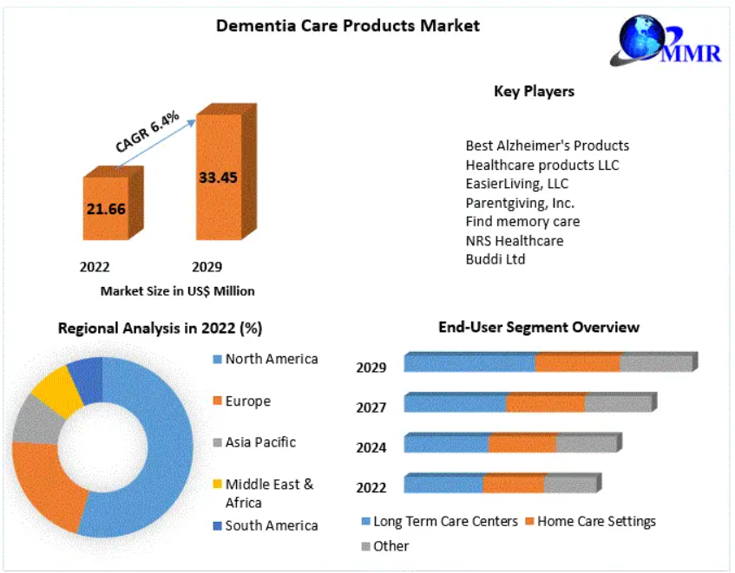
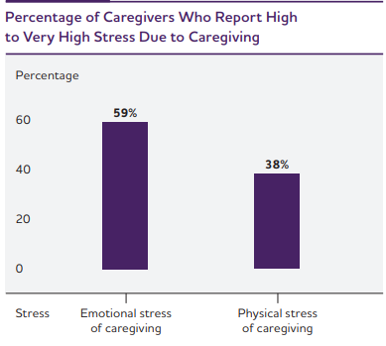
Our initiative
Background & Expectations

Slide 5

Product Overview
Effective
Simple
Interactive
Easy to operate
Functions & Positioning
Healthcare providers
Individuals
Research Institutions

Slide 6


Slide 7
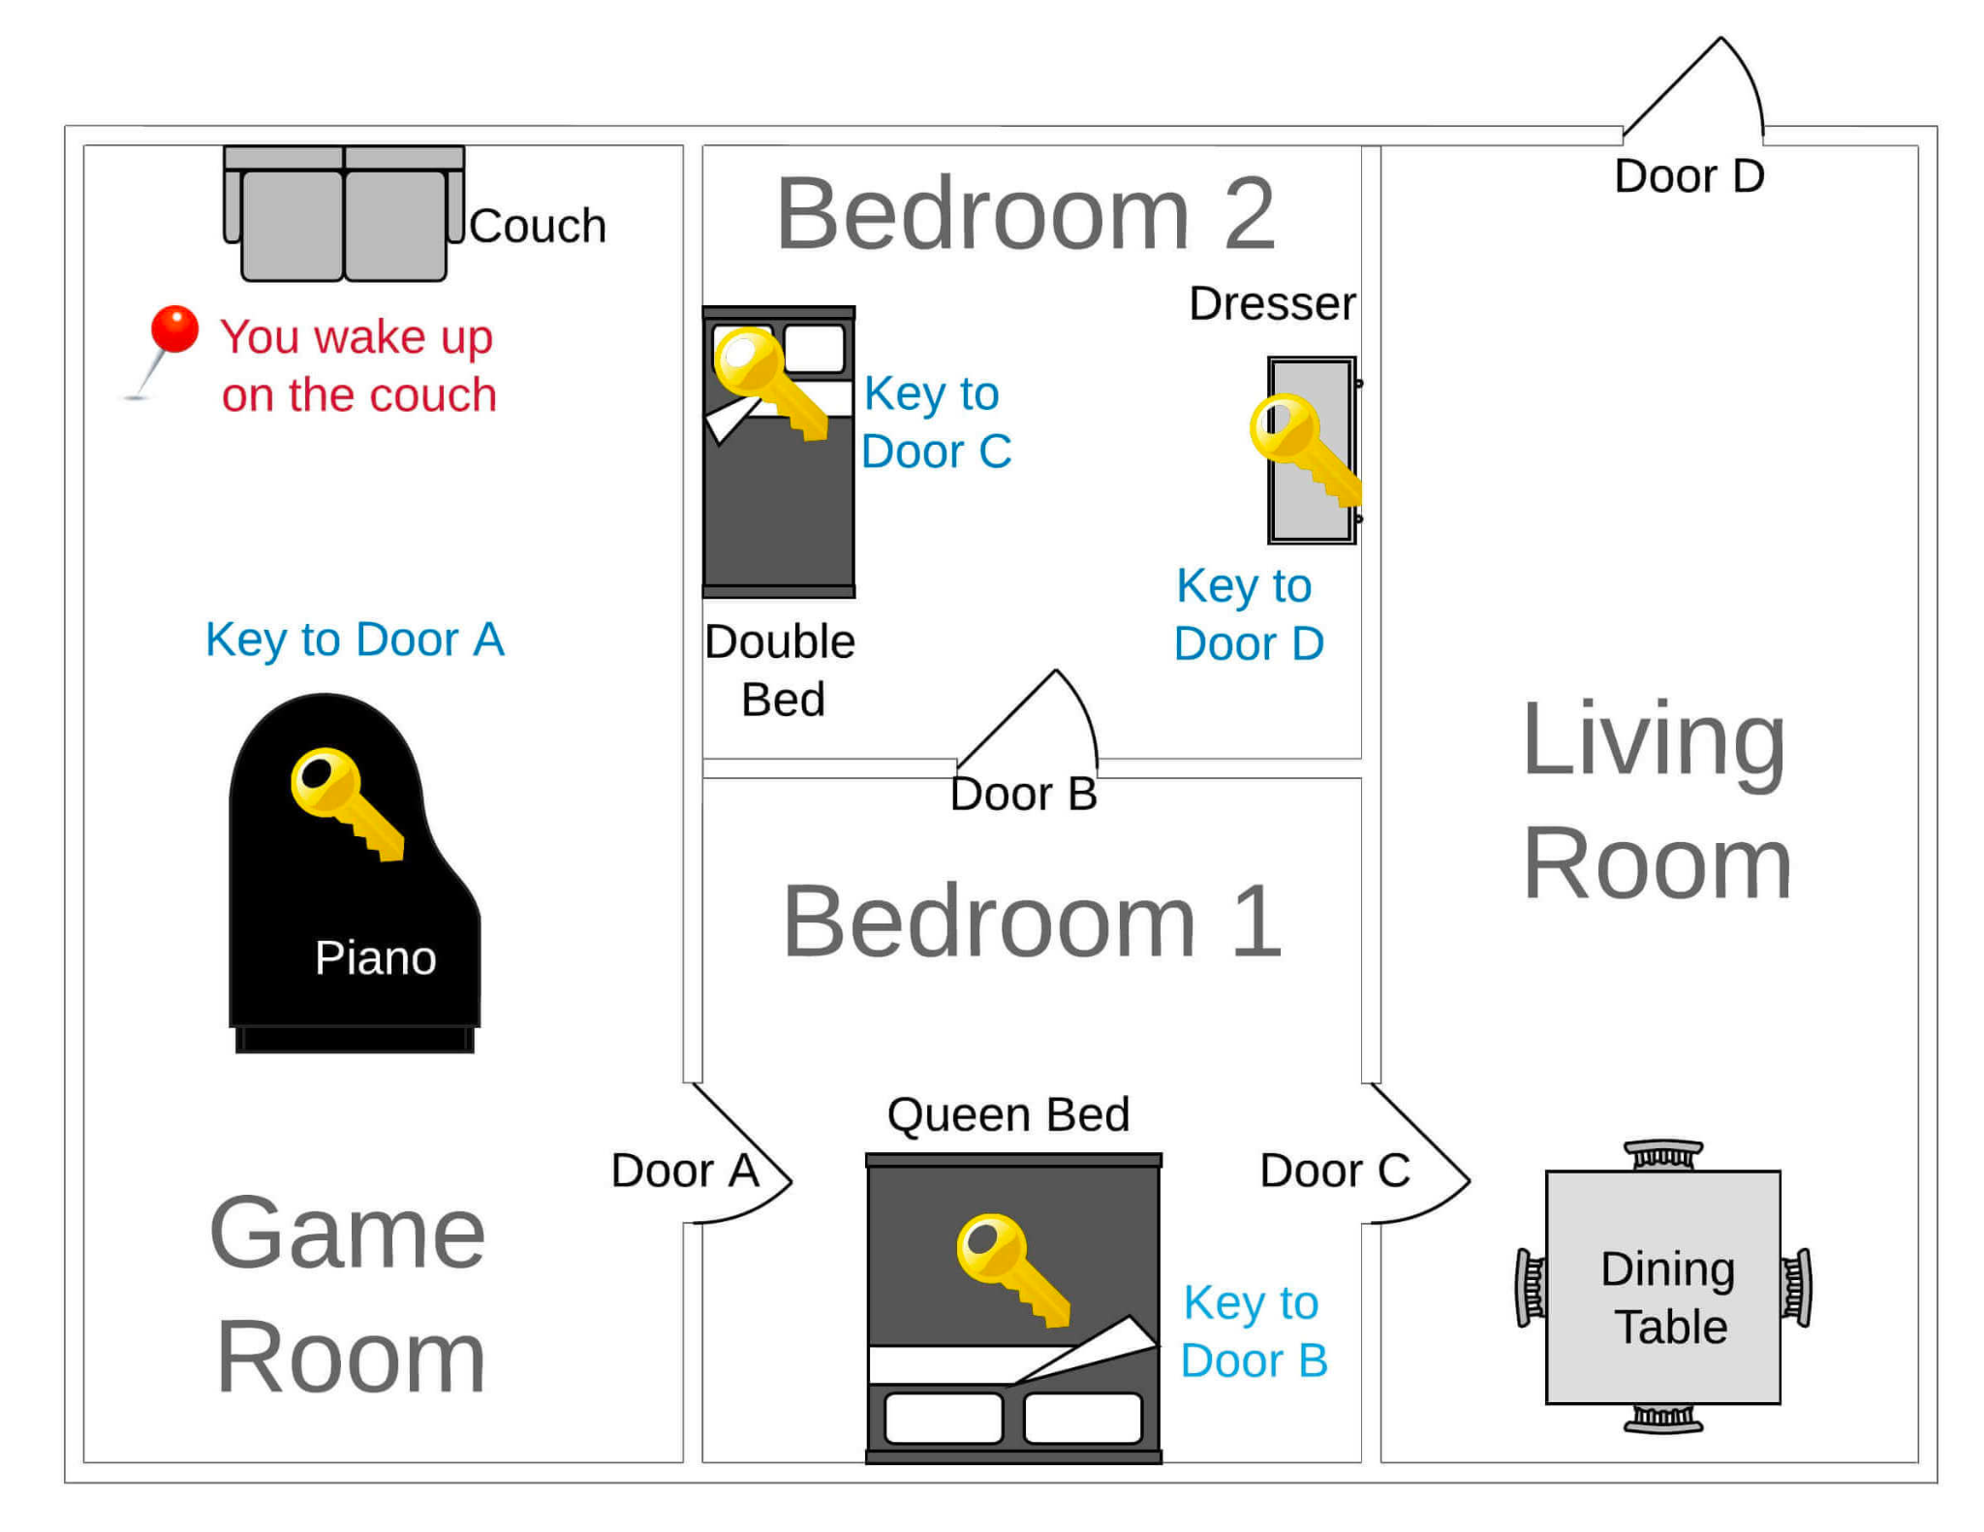
Product Overview
Achievement & Centralized Bottleneck
Reducing repetitive command
Video display(OpenCV)
Package expansion(Pygame)

Slide 8
Potential Features
Show Inventory Command
Video Game
Adaptive Difficulty Level

Slide 9
Questions?

Slide 10
Reference: https://www.maximizemarketresearch.com/market-report/global-dementia-care-products-market/24987/ https://www.alzint.org/about/dementia-facts-figures/dementia-statistics/#:~:text=Numbers%20of%20people%20with%20dementia,will%20be%20in%20developing%20countries.

